Slide 1
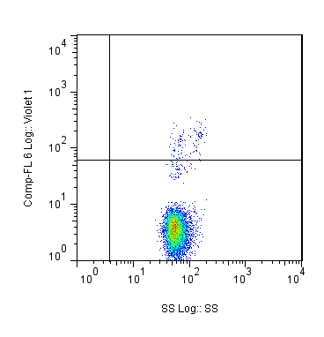
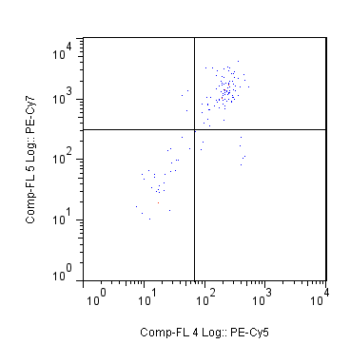
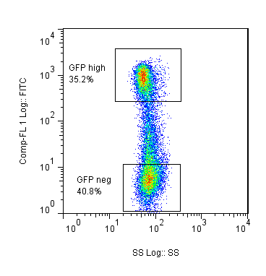
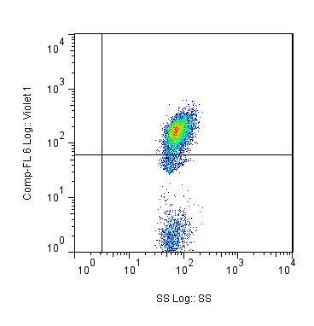
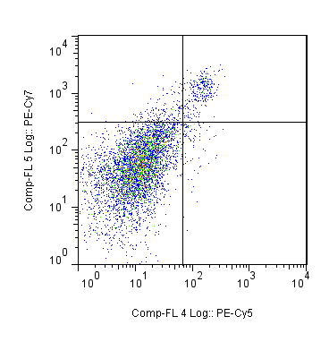
2.19%
69.2%
CD19
CD8
GFP^{high}
35.2%
Side Scatter
CD4
GFP
GFP⁻
40.8%
75.8%
5.14%
Side Scatter
CD19
CD8
Side Scatter
CD4

Slide 2
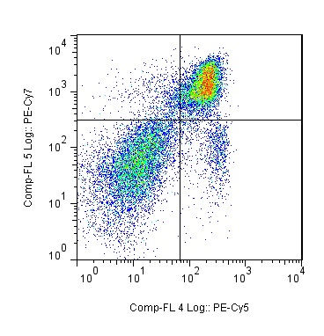
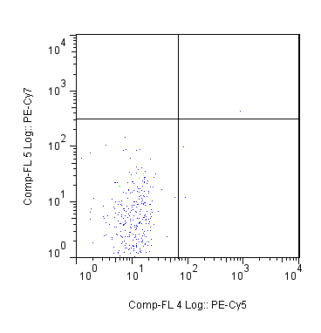
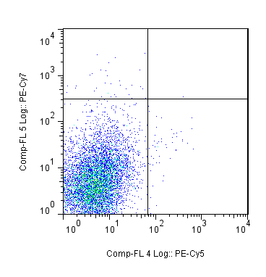
0.382%
Spln
CD8
CD8
CD4
CD4
0.009%
CD8
CD4

Slide 3
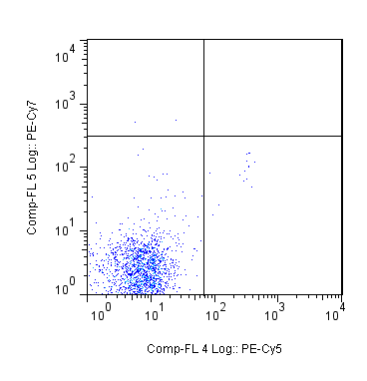
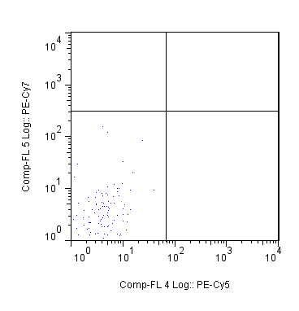
0.016%
0.000%
CD8
CD8
CD4
CD4

